Slide 1
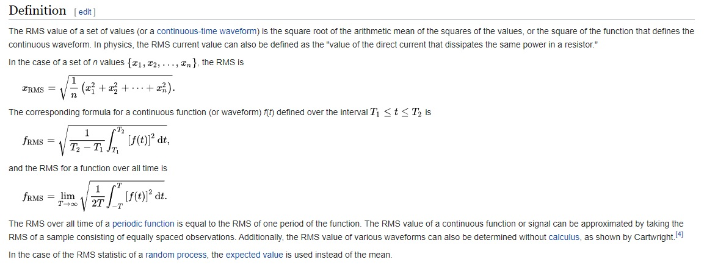
Things to Remember - RMS
.

Slide 2
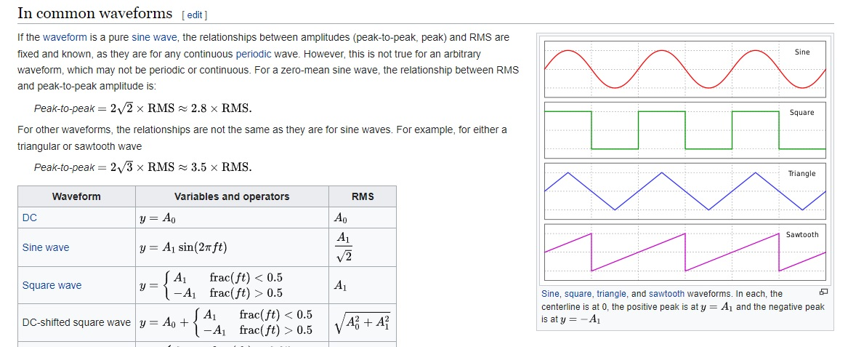
Things to Remember
.

Slide 3
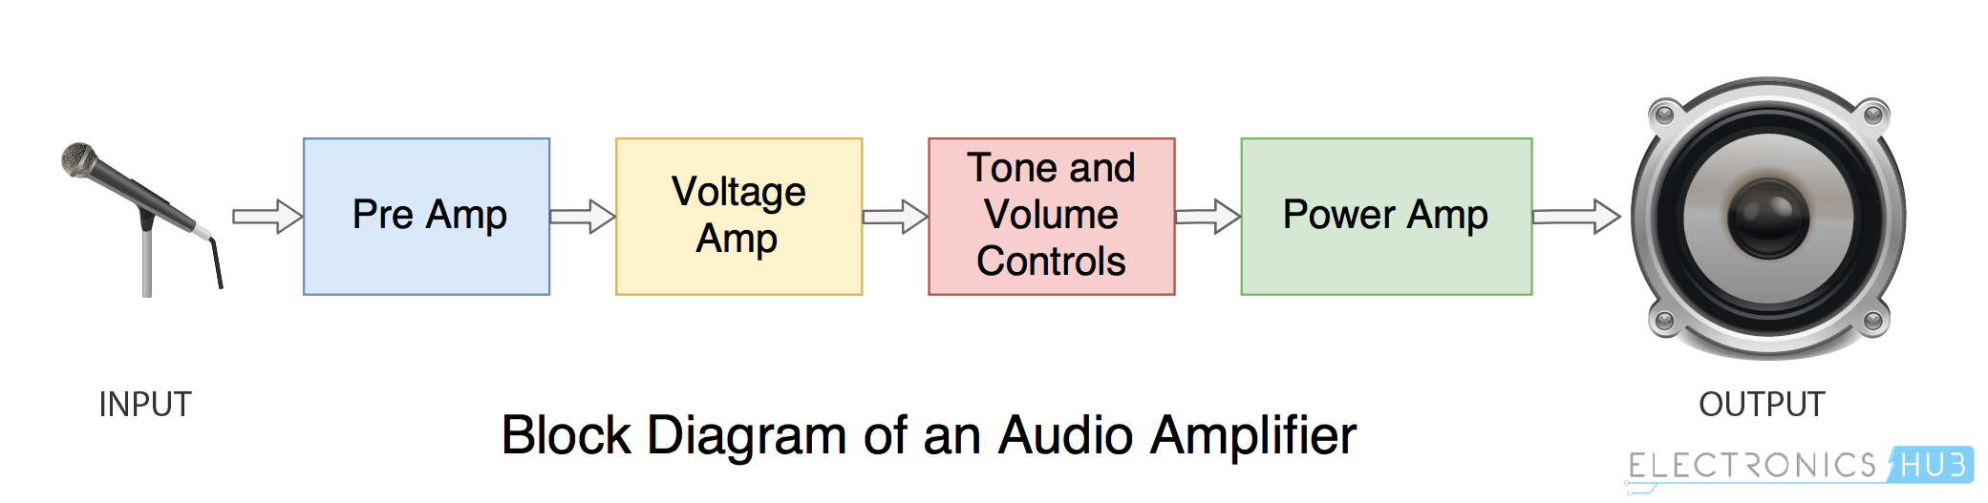










POWER AMPLIFIERS
.
An amplifier is an electronic device used to increase the magnitude of voltage/current/power of an input signal.
It takes in a weak electrical signal/waveform and reproduces a similar stronger waveform at the output by using an external power source.
What is a Power Amplifier?
A power amplifier is an electronic amplifier designed to increase the magnitude of power of a given input signal.
The power of the input signal is increased to a level high enough to drive loads of output devices like speakers, headphones, RF transmitters etc.

Slide 4
POWER AMPLIFIERS
.
Power amplifiers amplify the power level of the signal.
The power of the input signal is increased to a level high enough to drive loads of output devices like speakers, headphones, RF transmitters etc.
CLASSIFICATIONS
Based on their frequencies.
Audio Power Amplifiers – Audio frequency range 20 Hz to 20 KHz. Also Known as Small Signal Power Amplifiers.
Radio Power Amplifiers – Power level up to 3 Hz to 300 Hz. Also termed as Tuned Amplifiers and also known as Large Signal Power Amplifiers.
Mode of operation
The portion of the input cycle during which collector current flows, the power amplifiers may be classified as follows
Class A Power amplifier - When the collector current flows at all times during full cycle of the input signal.
Class B Power amplifier - When the collector current flows at only during half cycle of the input signal.
Class C Power amplifier - When the collector current flows for less than half cycle of the input signal.

Slide 5
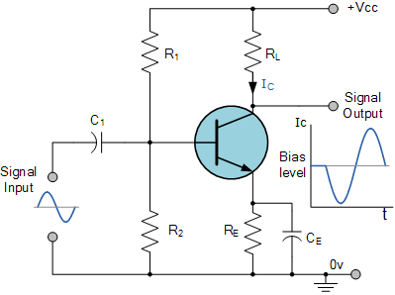
CLASS - A AMPLIFIER
Commonly used type of power amplifier configuration is the Class A Amplifier.
It uses a single switching transistor in the standard common emitter circuit configuration.
The transistor is always biased “ON” so that it conducts during one complete cycle of the input signal waveform producing minimum distortion and maximum amplitude of the output signal.
.

Slide 6
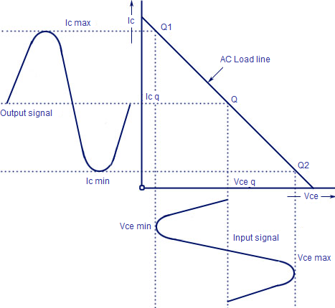
CHARACTERISTIC CURVES- CLASS A POWER AMPLIFIER

Slide 7
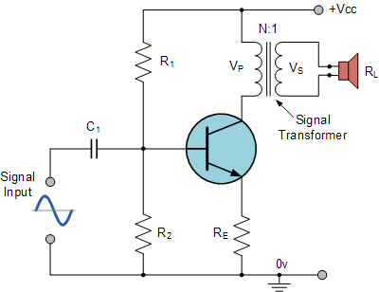









TRANSFORMER COUPLED CLASS – A AMPLIFIER
TRANSFORMER COUPLED CLASS - A AMPLIFIER

Slide 8
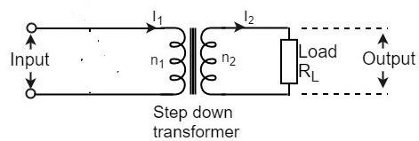
R₁ and R₂ -potential divider. Resistor R_{e} provides stabilization, R_{e} to prevent A.C. voltage.
The high impedance primary of the transformer is connected to the high impedance collector circuit. The low impedance secondary is connected to the load (generally loud speaker). Transformer used in the collector circuit is for impedance matching.
R_{L} is the load connected in the secondary of a transformer.
Number of turns in the primary are n₁ and the secondary are n₂.
V₁ and V₂ - primary and secondary voltages. I₁ and I₂ be the primary and secondary currents respectively.
When the input voltage is applied at the base terminal of the transistor operating in CE mode it leads to variation in base current, this variation in I_{B} produces similar variation in collector current and the output is taken across the load.

Slide 9








As the Collector current, Ic is reduced to below the quiescent Q-point set up by the base bias voltage, due to variations in the base current, the magnetic flux in the transformer core collapses causing an induced EMF in the transformer primary windings.
This causes an instantaneous collector voltage to rise to a value of twice the supply voltage 2Vcc giving a maximum collector current of twice Ic when the Collector voltage is at its minimum.
The efficiency of this type of Class A amplifier configuration can be calculated as follows.
R.M.S. Collector voltage is given as
R.M.S. Collector current is given as

Slide 10











The r.m.s. Power delivered to the load (Pac) is therefore given as
The average power drawn from the supply (Pdc) is given by
Efficiency of a Transformer-coupled Class A amplifier is given as
An output transformer improves the efficiency of the amplifier by matching the impedance of the load with that of the amplifiers output impedance.
By using an output or signal transformer with a suitable turns ratio, class-A amplifier efficiencies reaching 50%.
Advantages
Provides good DC isolation as there is no physical connection between amplifier output and load
Disadvantage - Additional cost and size of the audio transformer required.

Slide 11
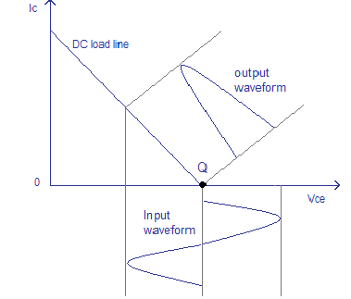
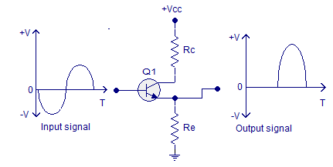
CLASS B POWER AMPLIFIER
It is a type of power amplifier where the active device (transistor) conducts only for one half cycle of the input signal. The conduction angle is 180° for a Class B amplifier.
The active device is switched off for half the input cycle, the active device dissipates less power and hence the efficiency is improved.
Theoretical maximum efficiency of Class B power amplifier is 78.5%.
Single ended Class B amplifier Class B – Output characteristics

Slide 12
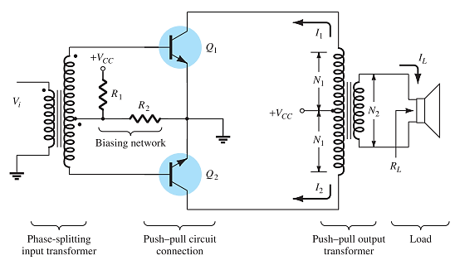
CLASS B PUSH-PULL AMPLIFIER
In practical Class B amplifier a pair of active devices (transistors) arranged in push-pull mode where one transistor conducts one half cycle and the other transistor conducts the other half cycle.
The output from both transistors are then combined together to get a scaled replica of the input.

Slide 13
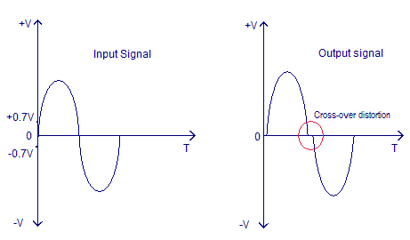
CROSS OVER DISTORTION
The regions of the input signal where the amplitude is less than 0.7V will be missing in the output signal and it is called cross over distortion.

Slide 14
ADVANTAGES OF CLASS B AMPLIFIER
High efficiency when compared to the Class A configurations.
Push-pull mechanism avoids even harmonics.
No DC components in the output (in ideal case).
DISADVANTAGES OF CLASS B AMPLIFIER.
The major disadvantage is the cross-over distortion. Coupling transformers increases the cost and size.
It is difficult to find ideal transformers.
Transformer coupling causes hum in the output and also affects the low frequency response.
Transformer coupling is not practical in case of huge loads.

Slide 15
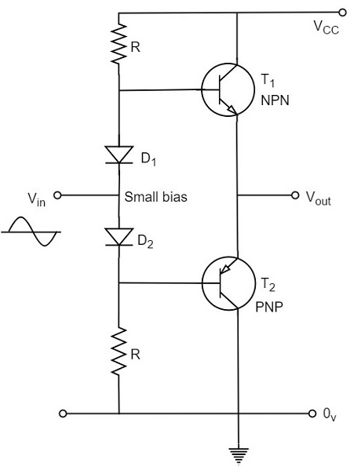
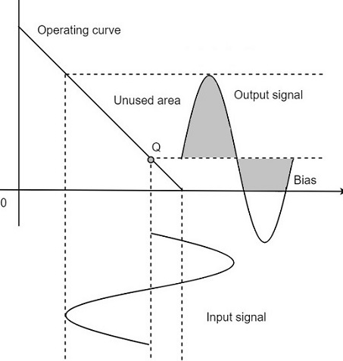
CLASS AB POWER AMPLIFIER
class AB is a combination of class A and class B type of amplifiers. As class A has the problem of low efficiency and class B has distortion problem, this class AB is emerged to eliminate these two problems, by utilizing the advantages of both the classes.
The cross over distortion is the problem that occurs when both the transistors are OFF at the same instant, during the transition period. In order to eliminate this, the condition has to be chosen for more than one half cycle. Hence, the other transistor gets into conduction, before the operating transistor switches to cut off state.

Slide 16
Advantages of Class AB power amplifier.
No cross over distortion.
No need for the bulky coupling transformers.
No hum in the output.
Disadvantages of Class AB power amplifier.
Efficiency is slightly less when compared to Class B configuration.
There will be some DC components in the output as the load is directly coupled.
Capacitive coupling can eliminate DC components but it is not practical in case of heavy loads.

Slide 17
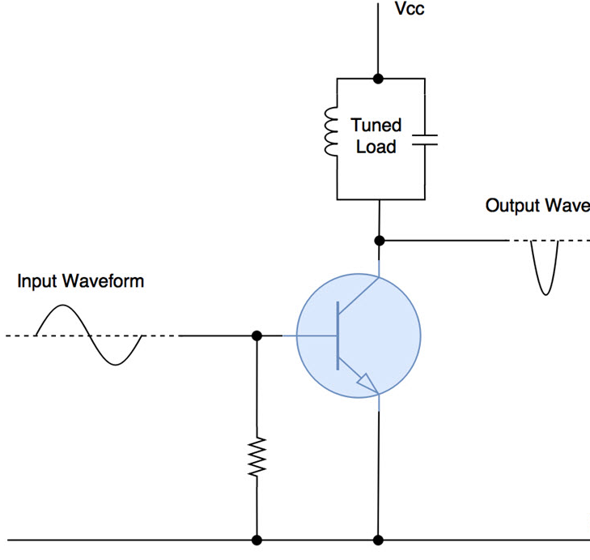
CLASS C POWER AMPLIFIER
Class C power amplifier is a type of amplifier where the active element (transistor) conduct for less than one half cycle of the input signal.
Less than one half cycle means the conduction angle is less than 180° and its typical value is 80° to 120°. The reduced conduction angle improves the efficiency to a great extend but causes a lot of distortion.
Theoretical maximum efficiency of a Class C amplifier is around 90%.

Slide 18
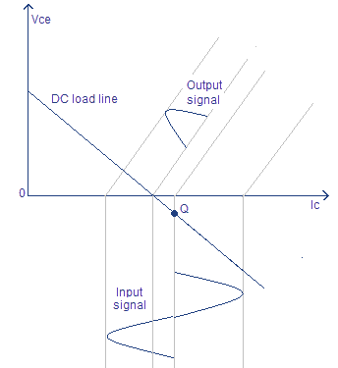
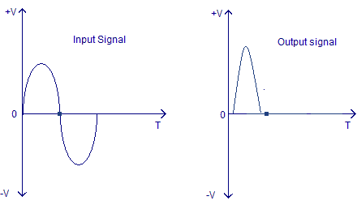
CLASS C POWER AMPLIFIER
Input and output waveforms - Class C power amplifier
Output Characteristics of Class C Power Amplifier

Slide 19
CLASS C POWER AMPLIFIER.
Advantages
High efficiency.
Excellent in RF applications.
Lowest physical size for a given power output.
Disadvantages
Lowest linearity.
Not suitable in audio applications.
Creates a lot of RF interference.
It is difficult to obtain ideal inductors and coupling transformers.
Reduced dynamic range.
Applications
RF oscillators.
RF amplifier.
FM transmitters.
Booster amplifiers.
High frequency repeaters.
Tuned amplifiers etc.

